Slide 1

ICT and the learning principles of the
Primary School Curriculum
Presented by: Maryam Abdulla Isa
April, 2019
Group#3 – Part 1

Slide 2

Numbers of Government Schools in Bahrain
Why In your opinion, the Numbers of Primary Schools are higher?

Slide 3
Numbers of Students in Government Schools of Bahrain

Slide 4

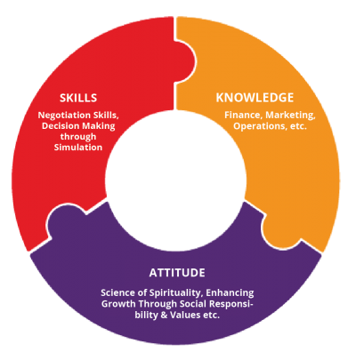
Why primary education is important?
Emotional and Physical
Cognitive
Development
of pupils
Social & Emotional
Notes:
The role of primary education is to ensure the broad-based development of pupils. This means ensuring that all pupils are able to develop their cognitive, social, emotional, cultural and physical skills to the best of their abilities, preparing them for their further school career.

Slide 5

The expected outcome of primary education is to sets the child to :
Live a full life as a child.
Realize his or her potential as a unique individual.
Develop as a social being through living and cooperating with others and also contribute to the good of society.
Be prepare for further education and lifelong learning.

Slide 6

Teachers Role in the child development in Primary education:
Sets the need of students in classrooms.
Develop and incorporate a range of teaching and learning resources into his or her teaching methods.
Be aware of the philosophy and content of the curriculum.
Use of tools and resources that can enhance the child’s learning.
Design learning experiences that support the broadly stated aims of the Primary School Curriculum.

Slide 7


Slide 8
Importance of ICT in Primary education
ICT Develops the higher cognitive skills in Blooms taxonomy because:
It enables kids to search for the information they need and to organize what they have found.
As children progress through the school system, they become increasingly responsible for their own learning.
Help kids to achieve better results in other subjects( as they connects finding logically ) and to find what they need and use information in particular ways.

Slide 9
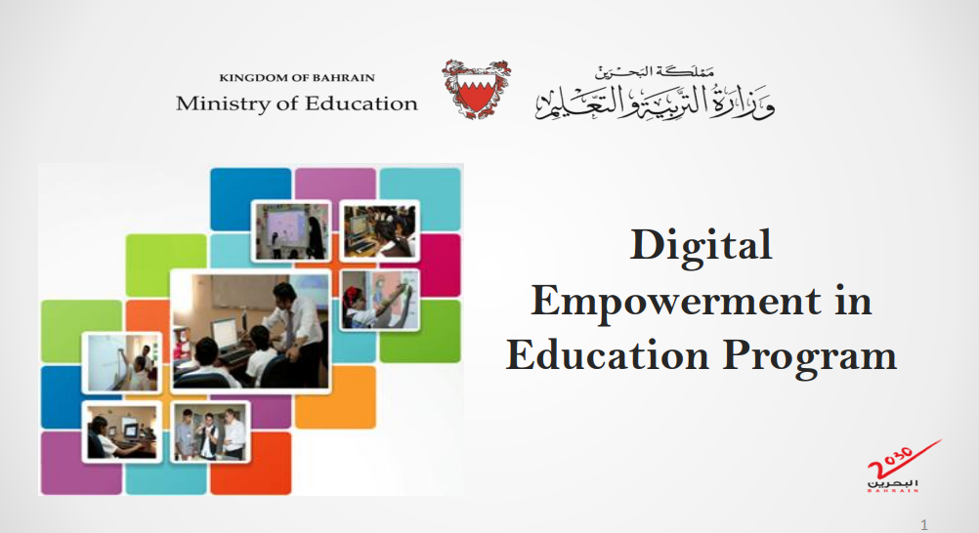

Slide 10
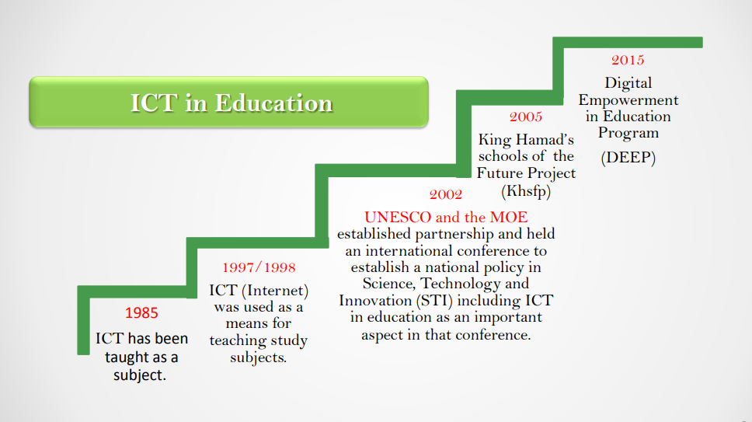

Slide 11
Aims of using ICT in elementary school is to enable the child in education to:
Use a range of ICT tools in a relevant curriculum context.
Develop and use ICT skills in the attainment of curriculum learning objectives.
Be confidence in his or her use of ICT, through enjoyable learning experiences.
Understand and practice of the safe use of ICT.
Overcome barriers of access to learning resources caused by geographic location, culture, or language.
Use ICT to support his or her learning effectively and creatively.
Inform Attitudes regarding the role of ICT in society, including the benefits and challenges of ICT use.
Develop social skills through cooperative learning and problem-solving.

Slide 12
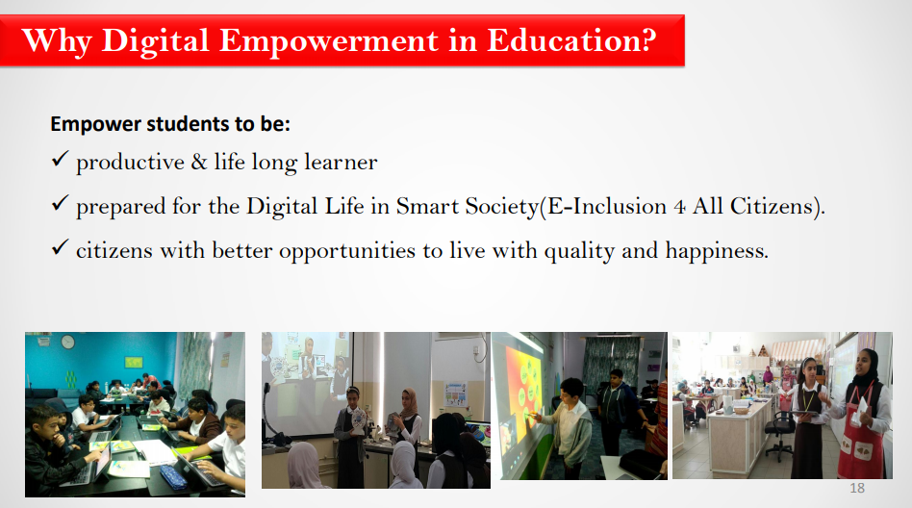

Slide 13
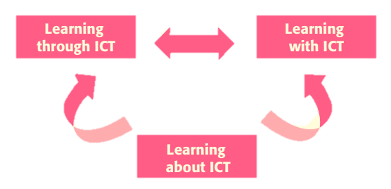
Using ICT in teaching and learning may be approached in three ways:

Slide 14
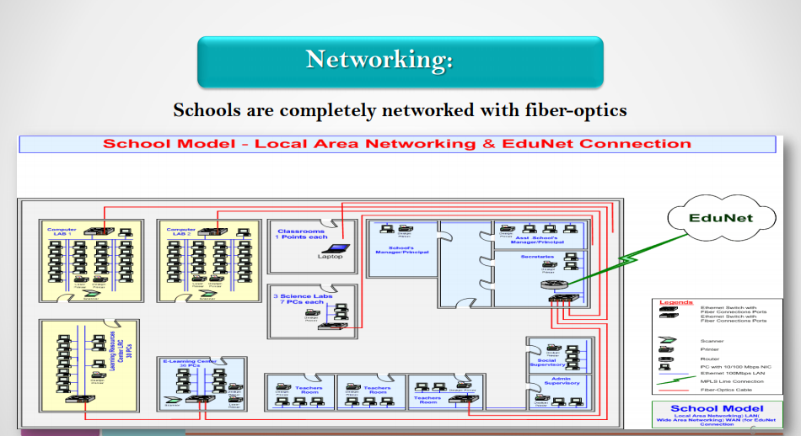

Slide 15
What are the ICT tools needed in the following case
A teacher of second grade class has a demonstration of the vines on the leave of “Lemon Plant” that he wants to clarify for student. He had to take round in class to show the vines to several groups of students? How can the teacher solve this problem with technology?
Documentary Cameras

Slide 16
So, which of the following ways we are using to implement the approach?

Slide 17
Learning With ICT
Teachers
Use
ICT Resources
Classroom Curriculum
Support
Students
Use
Notes:
Teachers and children use ICT resources to support the classroom curriculum.
The Ministry of education are now looking to enhance the education through multi resource technologies that are used in classrooms which supports the curriculum and teaching strategies

Slide 18
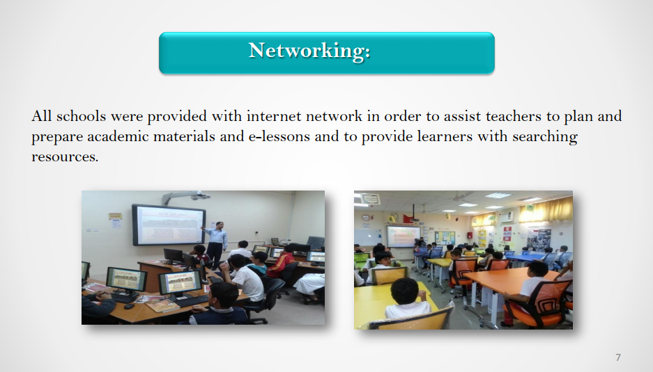

Slide 19
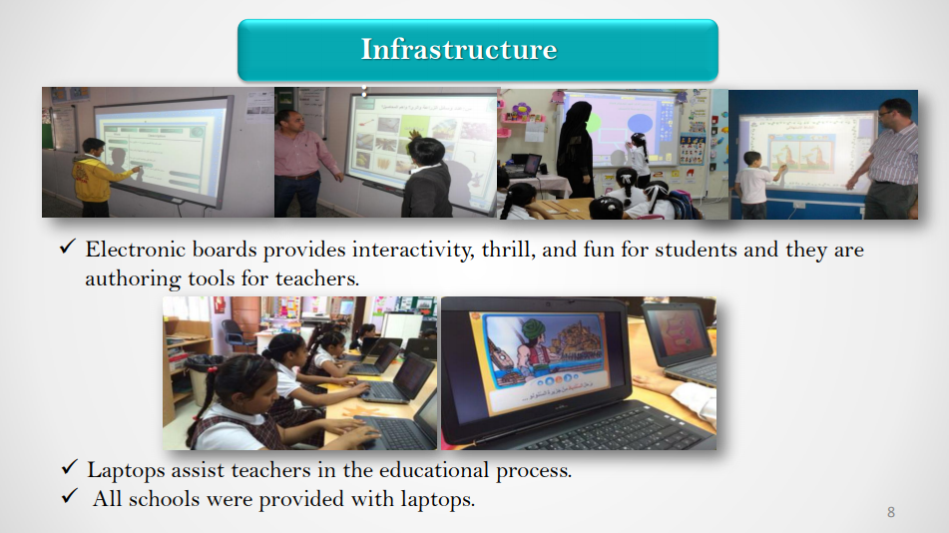

Slide 20
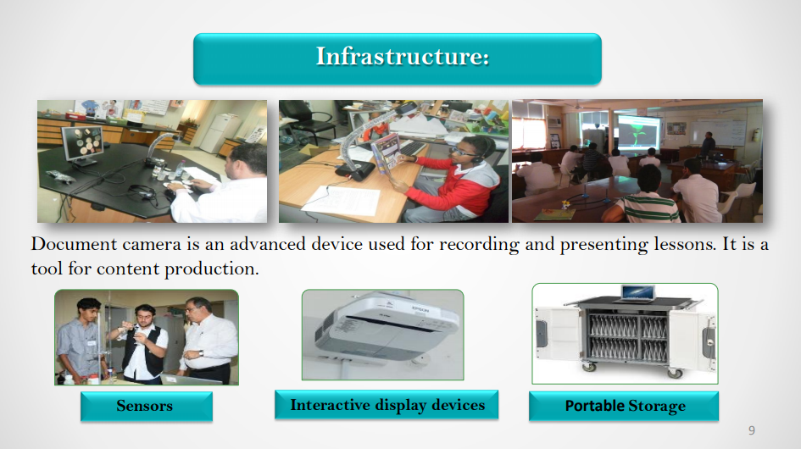

Slide 21
What are the ICT tools needed in the following case
A science teacher wanted to do an experiment of mixing severely hazarding chemicals. The curriculum insists that students preform this experiment to learn. And students have to explore the outcomes of the different elements.
Virtual Labs
Notes:
teachers and children use ICT to transform the process of teaching and learning, learning in new ways.

Slide 22
So, which of the following ways we are using to implement the approach?

Slide 23
Learning Through ICT
Teachers
Use
ICT Resources
New Ways
Learn
Students
Use
Notes:
Teachers and children use ICT to transform the process of teaching and learning, learning in new ways.

Slide 24
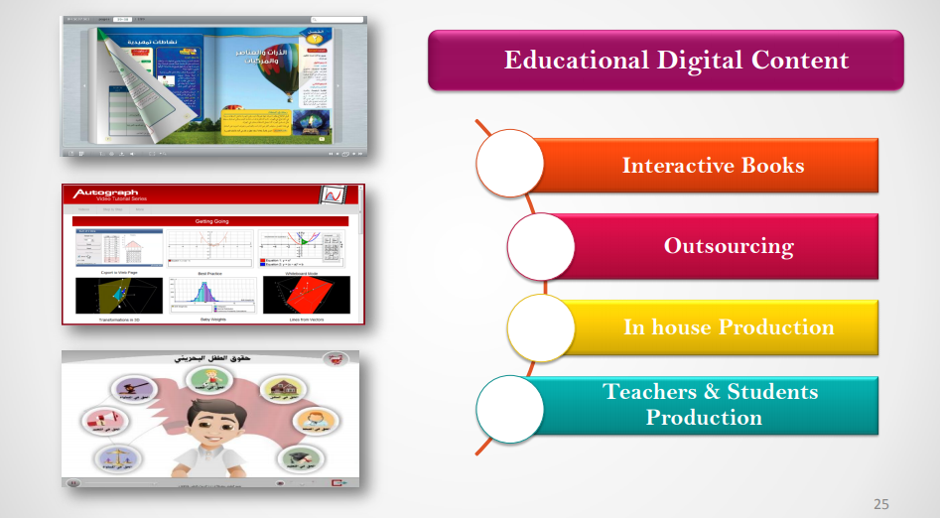

Slide 25
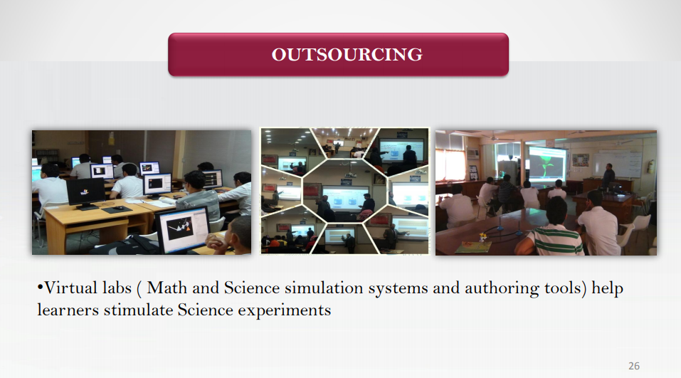

Slide 26
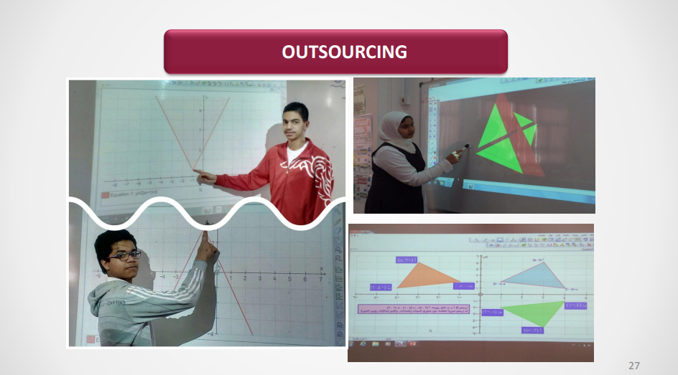

Slide 27
What are the ICT tools needed in the following case
A teacher wanted ICT-illiterate students to start using emails to ease the exchange process of the assignments, tasks and marks.
Computers, Internet & Emails
Notes:
teachers and children develop skills and knowledge in the potential uses of ICT to support learning.
The Ministry of education are now implementing ICT curriculums in schools for all levels of students to reach the 2030 vision

Slide 28
So, which of the following ways we are using to implement the approach?

Slide 29
Learning about ICT
Teachers
Develop Use
ICT Resources
Learning
Support
Students
Develop Use
Notes:
teachers and children develop skills and knowledge in the potential uses of ICT to support learning.

Slide 30
Numbers of Computer Labs in Government Schools of Bahrain
Primary
Intermediate
Secondary

Slide 31
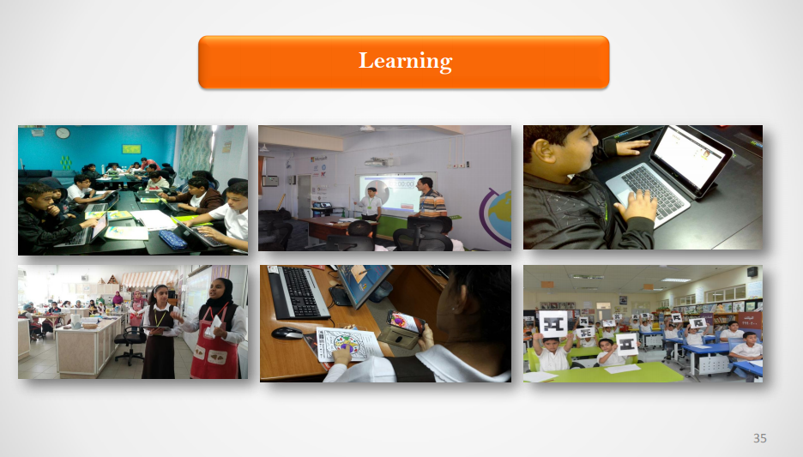
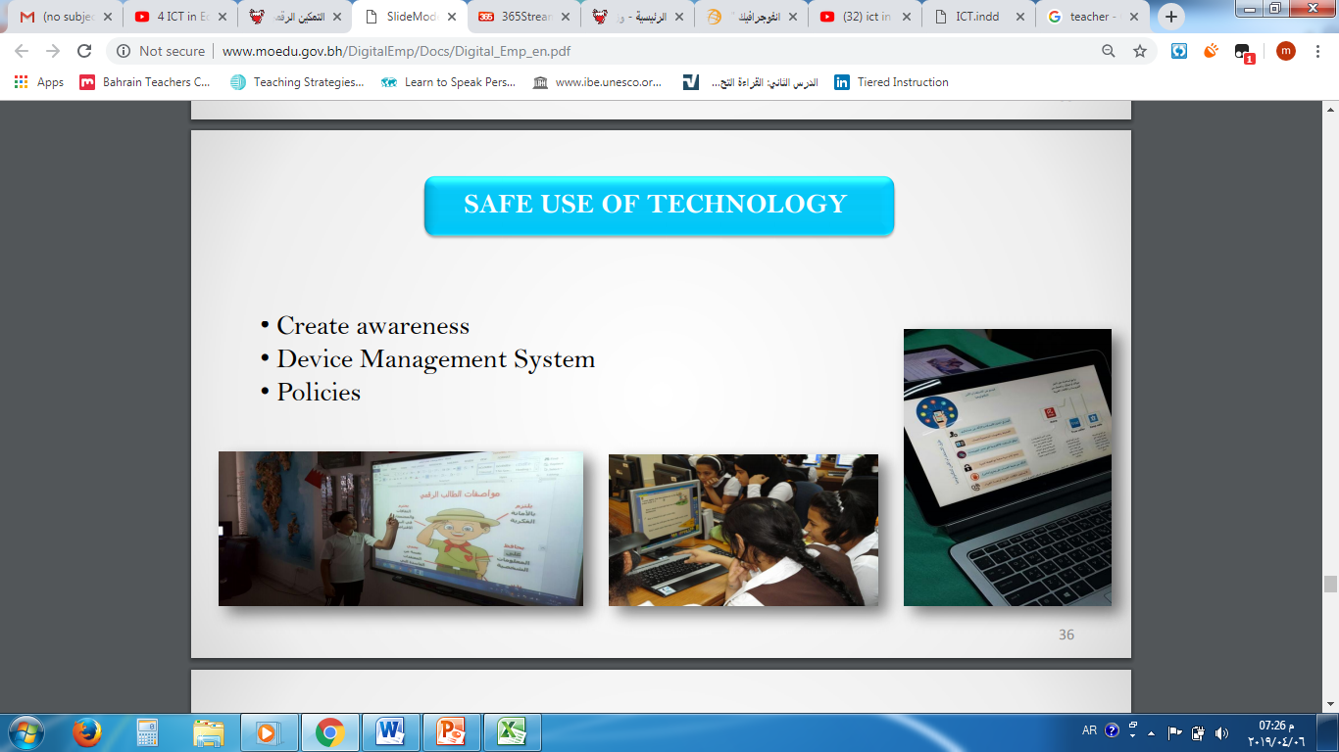

Slide 32
What Do we need to use ICT in teaching and learning according to three ways approach?
Resources
Trained Teachers
Support

Slide 33
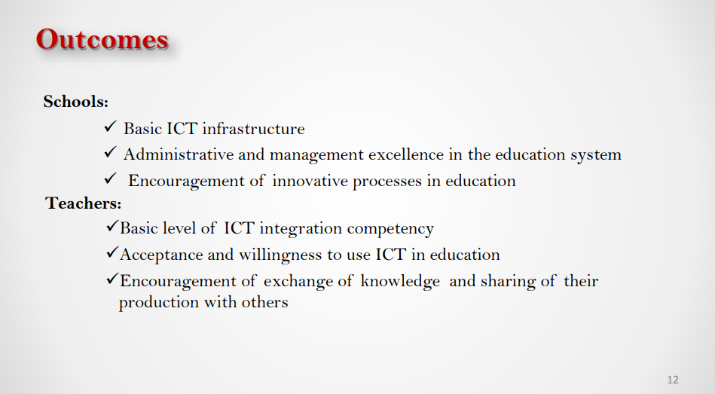
Resources

Slide 34
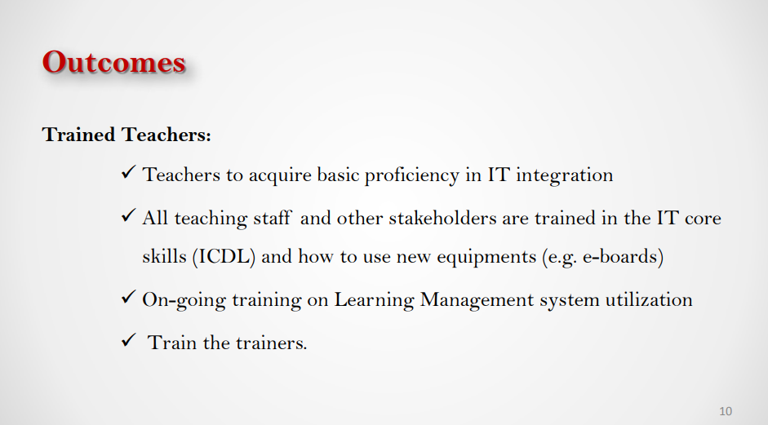
Trained Teachers

Slide 35
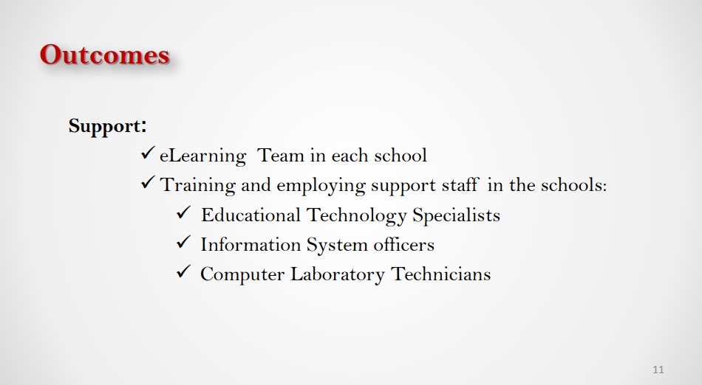
Support

