Slide 1
ICT and learning principles of the Primary
School Curriculum
Group #3 - Part 2
Asma Sowaileh
20171693

Slide 2
Agenda
The child’s sense of wonder and natural curiosity.
The child as an active agent in his or her learning.
The developmental nature of learning.
The child’s knowledge and experience as a base for learning.

Slide 3
Activity
In the provided worksheet, Give an example for each of these principles.
The child’s sense of wonder and natural curiosity.
The child as an active agent in his or her learning.
The developmental nature of learning.
The child’s knowledge and experience as a base for learning.

Slide 4

1. The child’s sense of wonder and natural curiosity.
2. The child as an active agent in his or her learning.
3. The developmental nature of learning.
4. The child’s knowledge and experience as a base for learning.
Children’s natural sense of wonder at the complexity of the world is a powerful motivation for their learning.

Slide 5


1. The child’s sense of wonder and natural curiosity.
2. The child as an active agent in his or her learning.
3. The developmental nature of learning.
4. The child’s knowledge and experience as a base for learning.
Teaching and learning strategies using ICT:
Exploring and investigating using the WWW.
  E.g. NASA site, the classroom of the future.
Using content-free software.
  E.g. presentation of real-world phenomena such as global warming.

Slide 6

1. The child’s sense of wonder and natural curiosity.
2. The child as an active agent in his or her learning.
3. The developmental nature of learning.
4. The child’s knowledge and experience as a base for learning.
Learning is an active process of constructing knowledge, rather than simply acquiring knowledge.

Slide 7
1. The child’s sense of wonder and natural curiosity.
2. The child as an active agent in his or her learning.
3. The developmental nature of learning.
4. The child’s knowledge and experience as a base for learning.
Teaching and learning strategies using ICT:
Enable the child to :
Find
Manage
Evaluate
Use
How?
By Providing access to a range of information resources.

Slide 8




1. The child’s sense of wonder and natural curiosity.
2. The child as an active agent in his or her learning.
3. The developmental nature of learning.
4. The child’s knowledge and experience as a base for learning.
Additional uses of ICT to support this principle of learning include:
Exploring Web Quests, and Learning quests.
Using drawing and paint software to create and edit designs and patterns.
Using digital cameras and digital video on field trips to capture images of events for project work, and for active engagement in the wider environment.

Slide 9
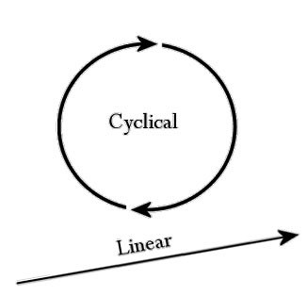
1. The child’s sense of wonder and natural curiosity.
2. The child as an active agent in his or her learning.
3. The developmental nature of learning.
4. The child’s knowledge and experience as a base for learning.
Conceptual development is more of a cyclical than a linear process for the child.
The Primary School Curriculum recommends that children receive regular opportunities to revisit concepts, information and skills that have already been acquired.

Slide 10

1. The child’s sense of wonder and natural curiosity.
2. The child as an active agent in his or her learning.
3. The developmental nature of learning.
4. The child’s knowledge and experience as a base for learning.
Uses of ICT to support this principle of learning include:
Create opportunities to revise concepts and skills embedded in game-like situations.
Provide Content-rich software, that offers tutorials, simulations, and practice problems, can be used effectively for the reinforcement or the revision of concepts.

Slide 11
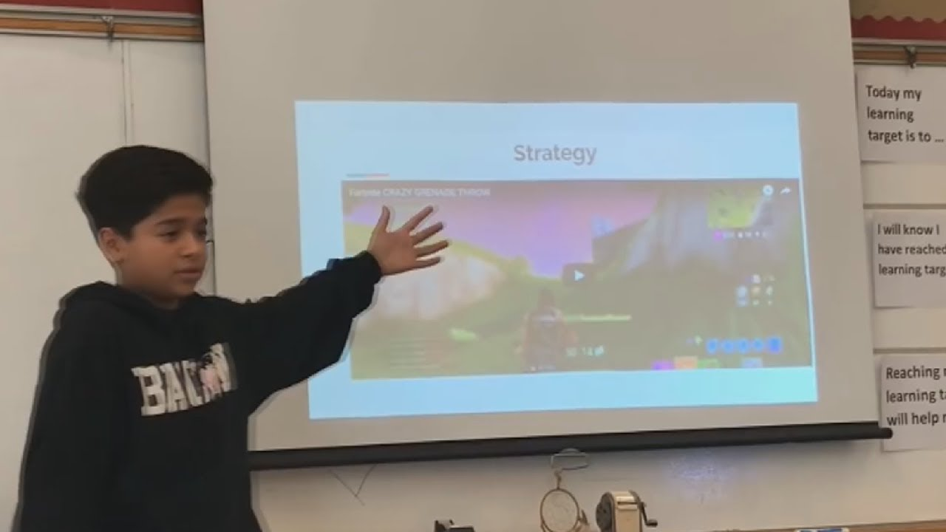
1. The child’s sense of wonder and natural curiosity.
2. The child as an active agent in his or her learning.
3. The developmental nature of learning.
4. The child’s knowledge and experience as a base for learning.
Children can use ICTs at different levels, dependent on their stage of development.
E.g. In the infant classes, children may use presentation software to create language experience charts.
Later, in the senior classes, they will use this same software to create complex presentations using text, audio, video, and images to create and display their projects.

Slide 12

1. The child’s sense of wonder and natural curiosity.
2. The child as an active agent in his or her learning.
3. The developmental nature of learning.
4. The child’s knowledge and experience as a base for learning.
It is a fundamental principle of the Primary School Curriculum that children’s existing knowledge and experience should be the starting point for acquiring new understanding.

Slide 13

1. The child’s sense of wonder and natural curiosity.
2. The child as an active agent in his or her learning.
3. The developmental nature of learning.
4. The child’s knowledge and experience as a base for learning.
Uses of ICT to support this principle of learning include:
Create an opportunity to select learning experiences that begin with each child’s knowledge and experience.

Slide 14
1. The child’s sense of wonder and natural curiosity.
2. The child as an active agent in his or her learning.
3. The developmental nature of learning.
4. The child’s knowledge and experience as a base for learning.
How?
1. Internet resources such as Web Quests offer the child a range of predetermined websites in a given content area.

Slide 15

1. The child’s sense of wonder and natural curiosity.
2. The child as an active agent in his or her learning.
3. The developmental nature of learning.
4. The child’s knowledge and experience as a base for learning.
2. Multimedia tools like video equipment enable children to record and chart their own learning progression.

Slide 16

1. The child’s sense of wonder and natural curiosity.
2. The child as an active agent in his or her learning.
3. The developmental nature of learning.
4. The child’s knowledge and experience as a base for learning.
3. The combined range of ICT tools enable the teacher and child to maintain a useful record of each child’s journey from the unknown to the known in the form of an electronic portfolio.

