Slide 1
ICT and learning principles of the Primary
School Curriculum
Part 4
Done by: Um Kalthoom Abdul Qader

Slide 2


Agenda
The social and emotional dimensions of learning.
Taking account of individual difference.

Slide 3
Content-rich software
Content-rich software as learning tools for children's use.
Content-rich software is divided into three categories:
1- Reinforcement software
2- Reference software
3- Exploratory software

Slide 4
1- Reinforcement software
It can support learning at different class and ability levels and in a variety of subject areas.
It offers children drill and practice activities.
It can form an integrated learning system, which is designed to teach, assess and record the activities of children while they are engaged with the software.
Reinforcement software can be used to support learning in every subject but is particularly useful in the areas of language and mathematics.

Slide 5
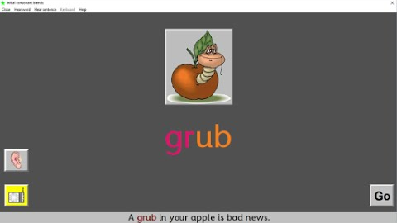
Examples of reinforcement software include:
Star Spell

Slide 6

Mighty Math Number Heroes

Slide 7
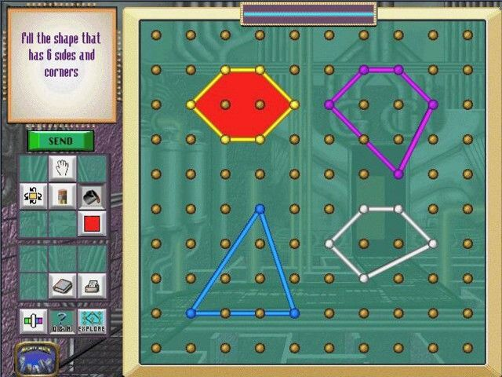

Slide 8
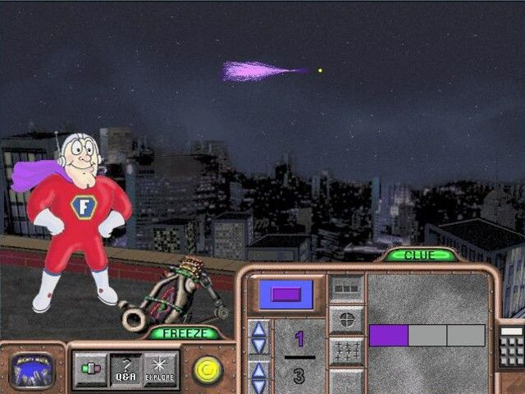

Slide 9
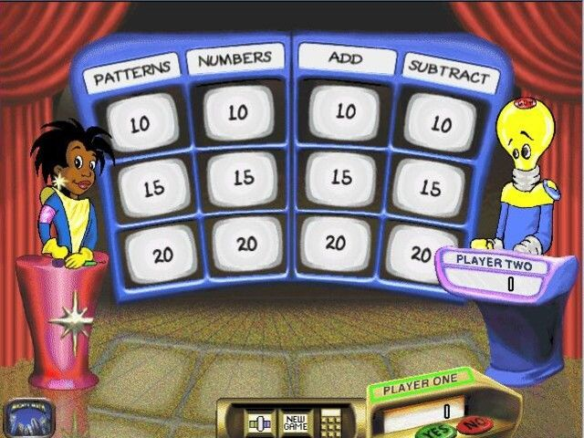

Slide 10
2. Reference software
Using it to select and retrieve information can develop higher-order thinking skills
Example:
Interactive books: available on disk and on CD-ROM

Slide 11
3. Exploratory software:
It replicates elements of the real world.
Exploratory software provides children with simulations, microworlds and adventure games that replicate elements of the real world.
Example:
journey into the human body game
flying a plane or a helicopter game

Slide 12

Principle of Learning:
The social and emotional dimensions of learning
9. The social and emotional dimensions of learning
10. Taking account of individual difference
The primary school curriculum
Child’s social and emotional development
His/her Success with learning in school
Recognises
Influences

Slide 13
Teaching and Learning Strategies using ICT:
The social and emotional dimensions of learning
9. The social and emotional dimensions of learning
10. Taking account of individual difference
ICT
Children increased opportunities
Success with learning
To experience
Can offer

Slide 14
ICT Offers opportunities to learn through :
- visual
- audio
- kinesthetic media
- text
For example:
Content rich software offers:
- Control over the level of information presented to the child
- The rate at which it is presented
- The formats for presenting information (image, text, audio)
9. The social and emotional dimensions of learning
10. Taking account of individual difference

Slide 15




Additional uses of ICT to support this principle of learning:
* Develop social skills through:
- Turn taking
- Sharing resources
- Helping other children in collaborative project work
* Collaborative classroom-based projects which use technology features such as:
- E-mail
- Chat
- Threaded discussion
- Video-conferencing
9. The social and emotional dimensions of learning
10. Taking account of individual difference

Slide 16

9. The social and emotional dimensions of learning
10. Taking account of individual difference
Example

Slide 17

Content-free software
Software which provides a structure into which data in the form of text, numbers, or programming, can be entered and manipulated.
Example:
Word processor

Slide 18
Concept mapping software
Concept mapping software allows users to effortlessly create concept maps on their computer.
Example:
MindView

Slide 19
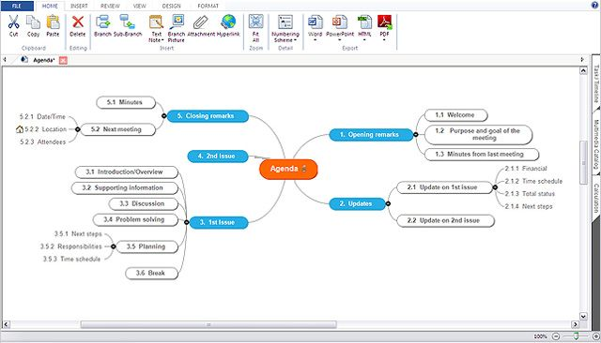
MindView Concept Mapping Software

Slide 20
Principle of Learning:
Taking account of individual difference
9. The social and emotional dimensions of learning
10. Taking account of individual difference
Individual difference in learning
Primary School Curriculum
Recognises
Factors that pertain to the child’s home and community life
Recommends that children benefit from
Sequencing of curriculum content
Differentiation in the selection

Slide 21
Teaching and Learning Strategies using ICT:
Taking account of individual difference
9. The social and emotional dimensions of learning
10. Taking account of individual difference
ICT tools Positively influence the child’s interest in the relevant curriculum subject

Slide 22
Additional uses of ICT to support this principle of learning:
* Content-rich software:
- Represents information to more than one format (text, audio, image, etc.)
- Provides options for pacing and sequencing of information.
9. The social and emotional dimensions of learning
10. Taking account of individual difference

Slide 23
Additional uses of ICT to support this principle of learning:
* The range of content-free software available including writing, multimedia and concept mapping software
*Creation of worksheets templates and reinforcement software
* ICT assessment tools such as electronic portfolios.
9. The social and emotional dimensions of learning
10. Taking account of individual difference

Slide 24
References:
http://archive.laoisedcentre.ie/ictgu/soft3.html
https://www.fishermarriott.com/Products/Details/StarSpell%203
https://www.mobygames.com/game/windows/mighty-math-number-heroes
https://www.tandfonline.com/doi/abs/10.1080/03004278885200041?journalCode=rett20
https://encyclopedia2.thefreedictionary.com/content-free
https://www.matchware.com/concept-mapping-software

