Slide 1


Technology & Assessment
University of Bahrain
Bahrain Teachers College
TCDEIT586-Theoritical Framework for ICT-Supported Teacher Education
Presented by: Hasna’a Jaffer Al-Saeed
ID#:20011935
May, 2019
Group#3 – Part 6

Slide 2


Before We Start>>>
Let’s Discuss this statement:
Assessment is integral to all areas of the curriculum and it encompasses the diverse aspects of learning ; the cognitive, the creative, the effective, the physical and the social.
Primary School Curriculum,1999,p.18

Slide 3
Before We Start>>>
So .. in your opinion:
What is the role of assessment in primary schools’ curriculum??

Slide 4

Agenda
Role of Assessment in Primary Schools.
Types of Assessments.
Why We Use Technology to Assess Learning?
How Technology Can be Used to Assess Student Learning?
Examples of Using Technology for Assessment in Bahrain Government School.
Practical Examples of Technology for Assessment.

Slide 5


Role of Assessment in Primary Schools
Assessment
formal
unformal
about
Learning
needs
Use
To
make changes to teaching approaches as necessary
Teacher

Slide 6

Role of Assessment in Primary Schools
ICT
Support
Construct a comprehensive picture of the:
Child short and long term learning needs
Child progress.
Teacher

Slide 7
Role of Assessment in Primary Schools
Reinforcement
Software
-grading
-reporting progress
-motivate students
Database and Spreadsheet
Software
-electronic records of child’s progress
-communicate information with parents, partners
PDAs
Personal Digital Assistants
-portable devices
-exchange information with PDAs and PCs
-additional source of real time assessment information(i.e.notes,records..etc.)
Digital
Portfolios
-durable records of children’ work
-writing tools
-presentations
-multimedia authoring
-concept mapping
Assistive Technology
-devices used to improve functional capabilities of individuals with disabilities and maximize their quality of life.

Slide 8
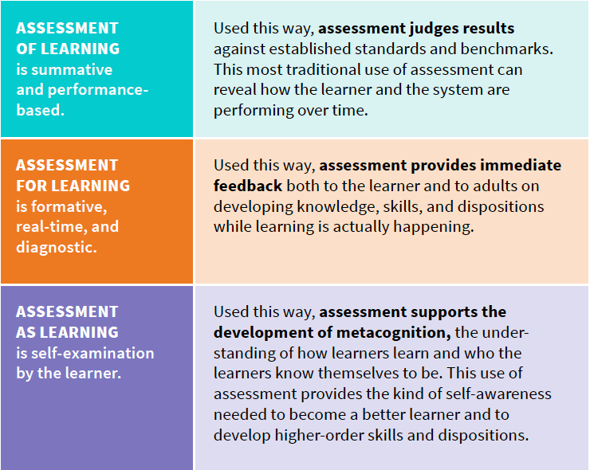
Types of Assessments
Which Type of Assessments Can be Accomplished by Technology?
How?

Slide 9

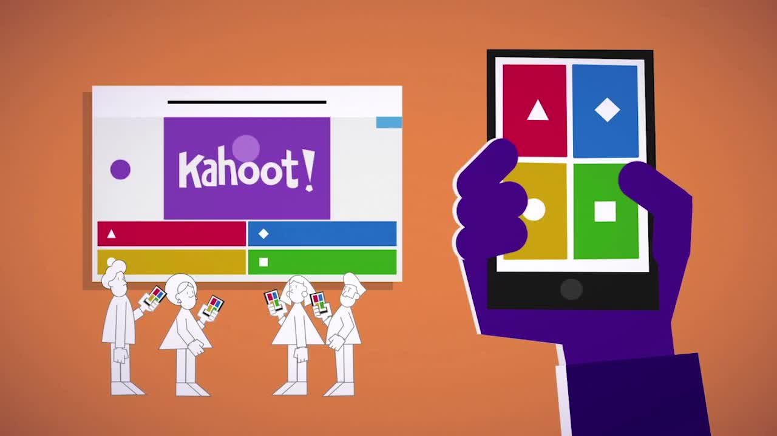
Technology Can be Used for All Types of Assessments
Formative Assessment
Online Discussion on Social Media. (Ex: Edmodo)
Summative Assessment
Using Word Processing to Write a Reflection.
Taking Videos/Photos for Our Teaching in Classrooms and Reflect on them. (Ex: TP)
Kahoot.
Triventy.
OTHER EXAMPLES???

Slide 10
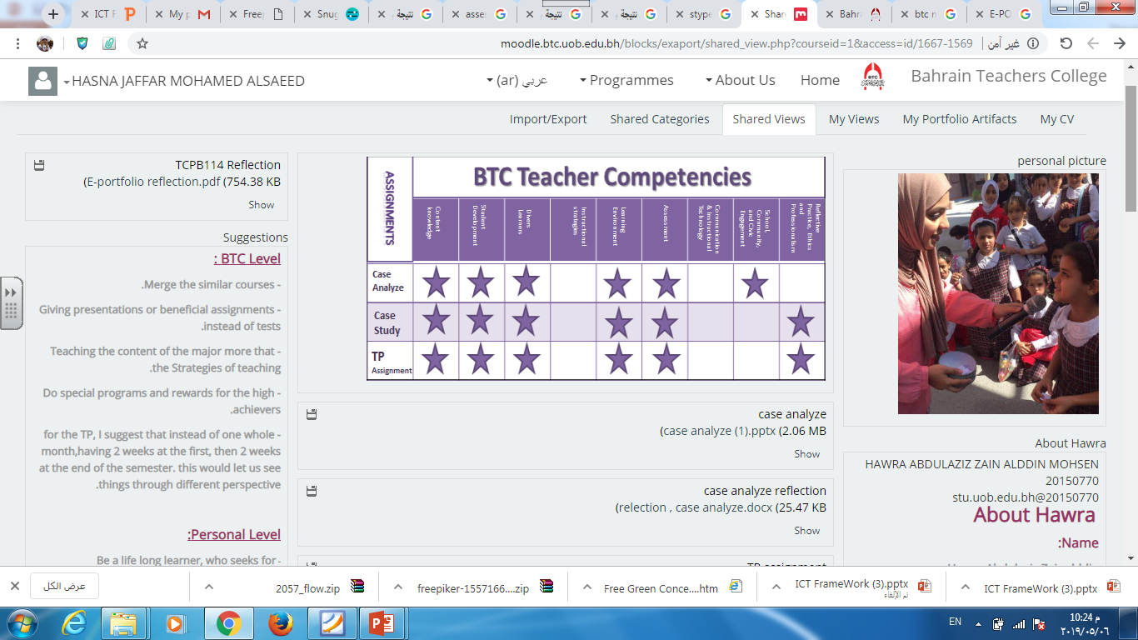
Technology Can be Used for All Types of Assessments
Formative Assessment
Summative Assessment
E-Portfolio and Digital Artifacts.
Essay.
Demonstrations.
Digital Projects.

Slide 11
Why We Use Technology to Assess Learning?
Increased Feedback
Increased Flexibility
Increased Opportunity
Increased Ownership
Assign Peer-Review Activities.(Ex:Padlet)
Various ways in providing feedback for students (Ex:iPad Apps(http://www.iannotate.com)
Low-stakes or No-Stakes Quizzes Online/Use Large Questions Pools for Practice
Ownership of students of the way to show their learnings.(Ex: E-Portfolio)

Slide 12


How Technology Can be Used to Assess Student Learning?
You have to choose the appropriate technologies to assess student learning. How??
Let’s watch this video>>>
Development
of pupils
https://www.linkedin.com/learning/teaching-with-technology/choosing-appropriate-technologies-to-assess-learning

Slide 13
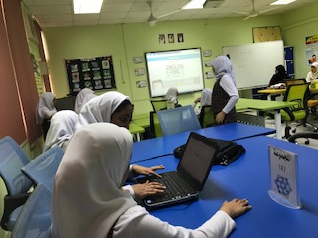
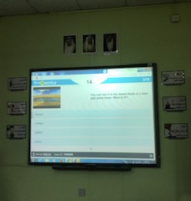

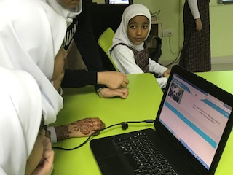
Examples of Using Technology for Assessment in Bahrain Schools

Slide 14
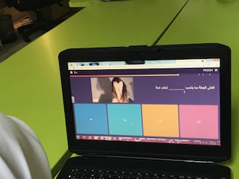
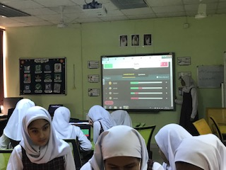

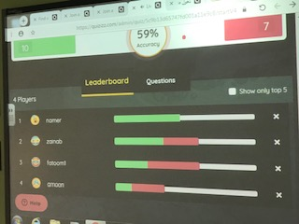
Examples of Using Technology for Assessment in Bahrain Schools

Slide 15
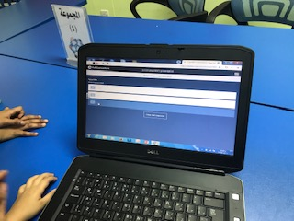
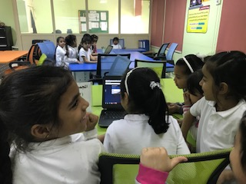

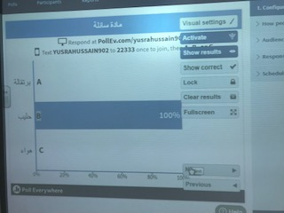
Examples of Using Technology for Assessment in Bahrain Schools

Slide 16
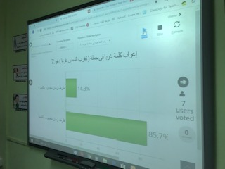
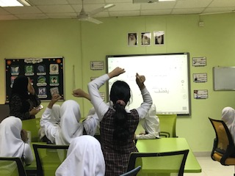

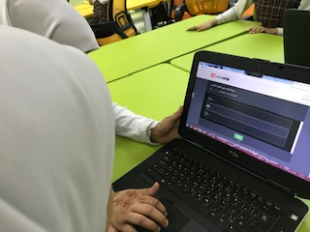
Examples of Using Technology for Assessment in Bahrain Schools

Slide 17
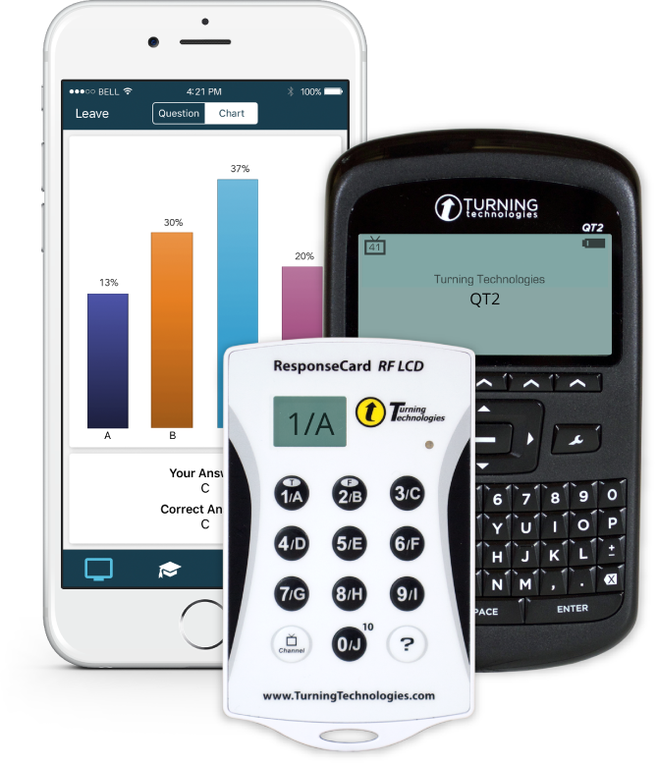
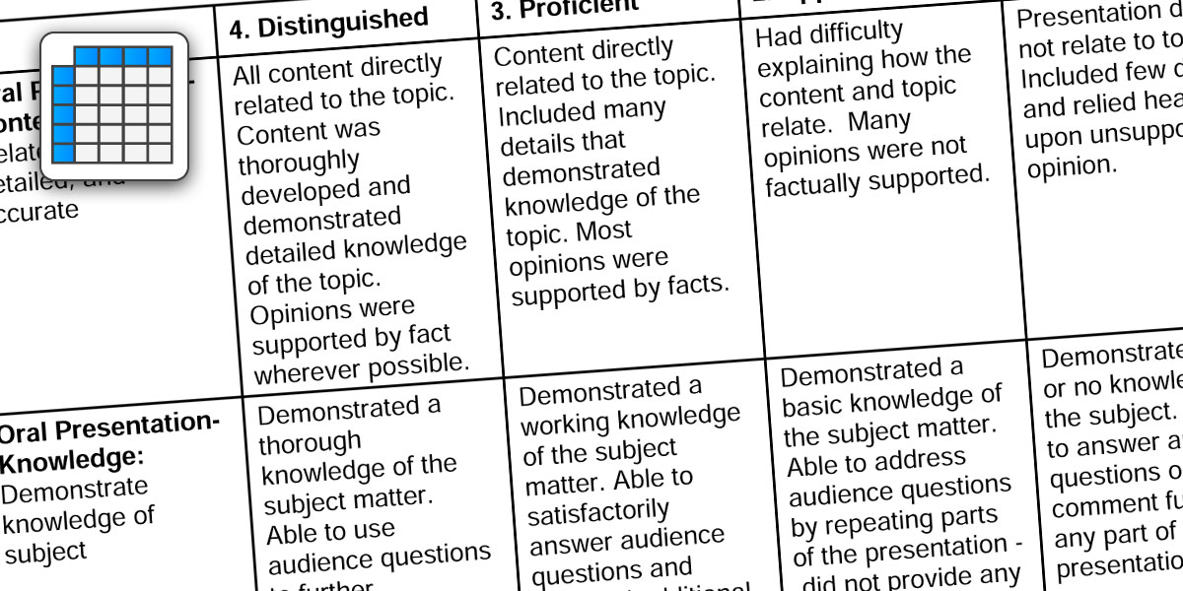
Practical Examples of Technology for Assessment
Clickers and Clickers Apps
Formative Assessment
Rubric Creator
Summative Assessment

Slide 18
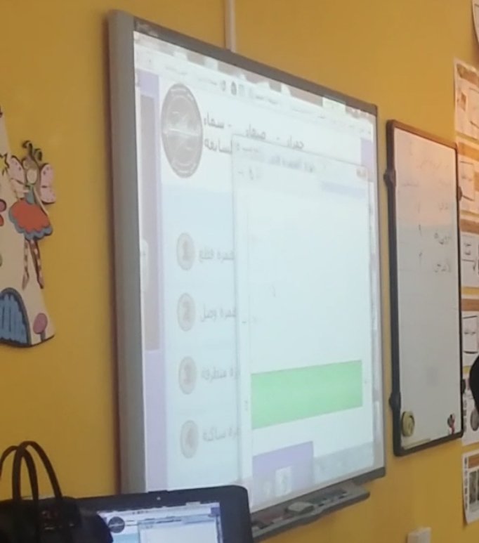
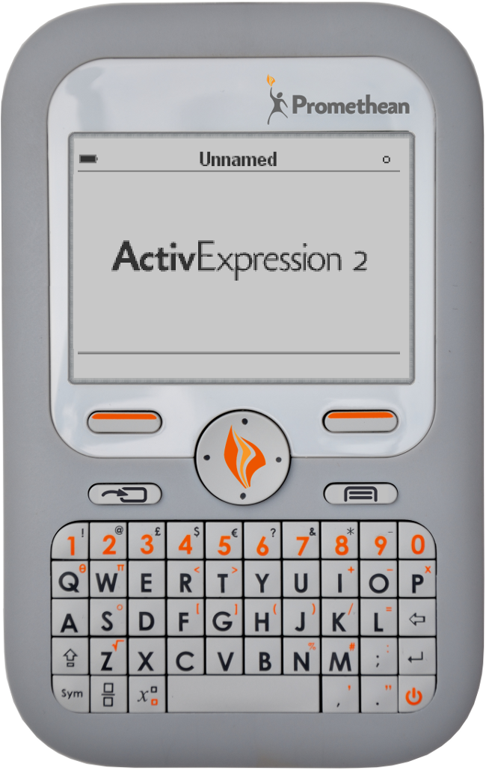
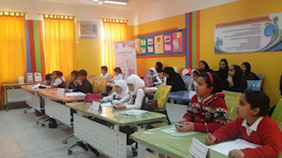
Practical Examples of Technology for Assessment
Clickers and Clickers Apps
Formative Assessment

Slide 19
What are Clickers?
Small handheld devices used in the classroom to collect student responses to interactive tests and quizzes.
A personal response system, student performance system.
Classroom performance system , classroom communication system, audience response system or an interactive response system.
The goal of this technology is to promote communication and interaction in face-to-face classes.

Slide 20

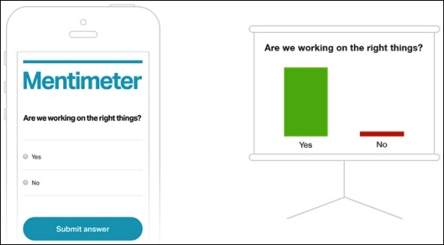
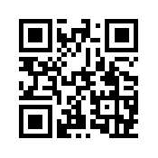
Example of a Clicker
Audience Response System
https://www.mentimeter.com/

Slide 21

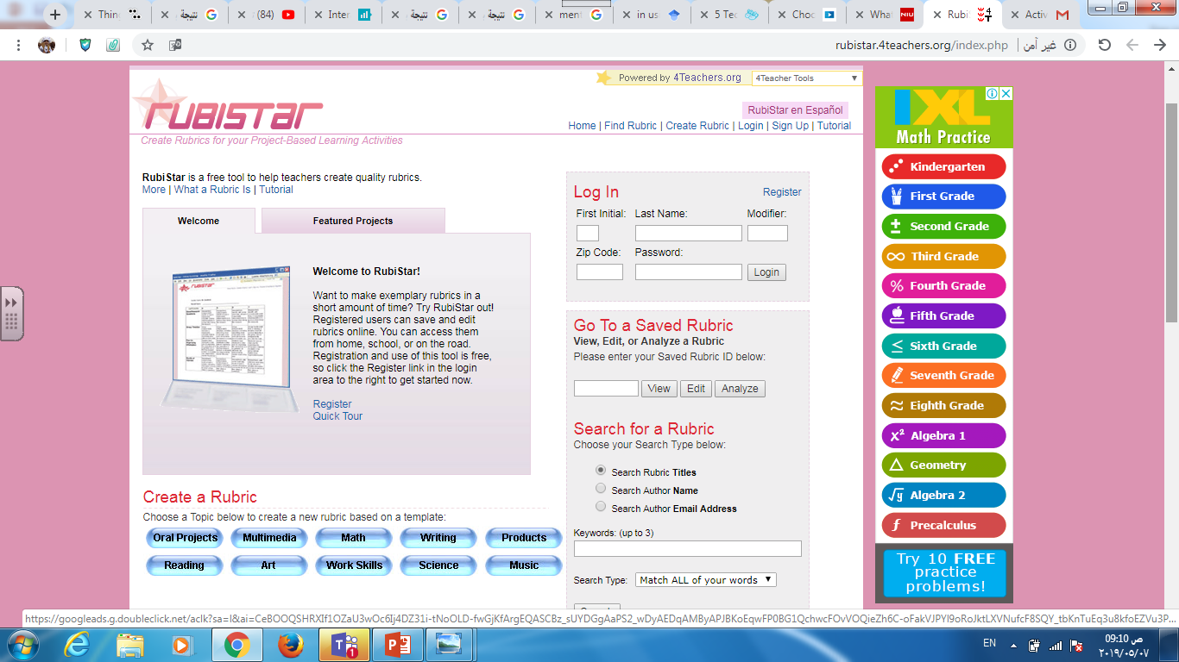
Example of a Rubric Creator
Create Rubrics for Project-Based Activities
http://rubistar.4teachers.org/index.php

Slide 22

Important Note
Technology is only a tool, but assessment is a practice designed by teachers.

Slide 23
References
Associate Degree in Education.B.Ed. (Hons) Elementary(2012). Information and Communication Technologies in Education, Higher Education Commission
http://rubistar.4teachers.org/index.php
https://www.facdev.niu.edu/facdev/resources/quicktips/transcripts/clickers.shtml
https://www.linkedin.com/learning/teaching-with-technology
https://www.mentimeter.com/
Information and Communication Technology(ICT) in the Primary School Curriculum:Guidelines for Teachers

